Slide 1
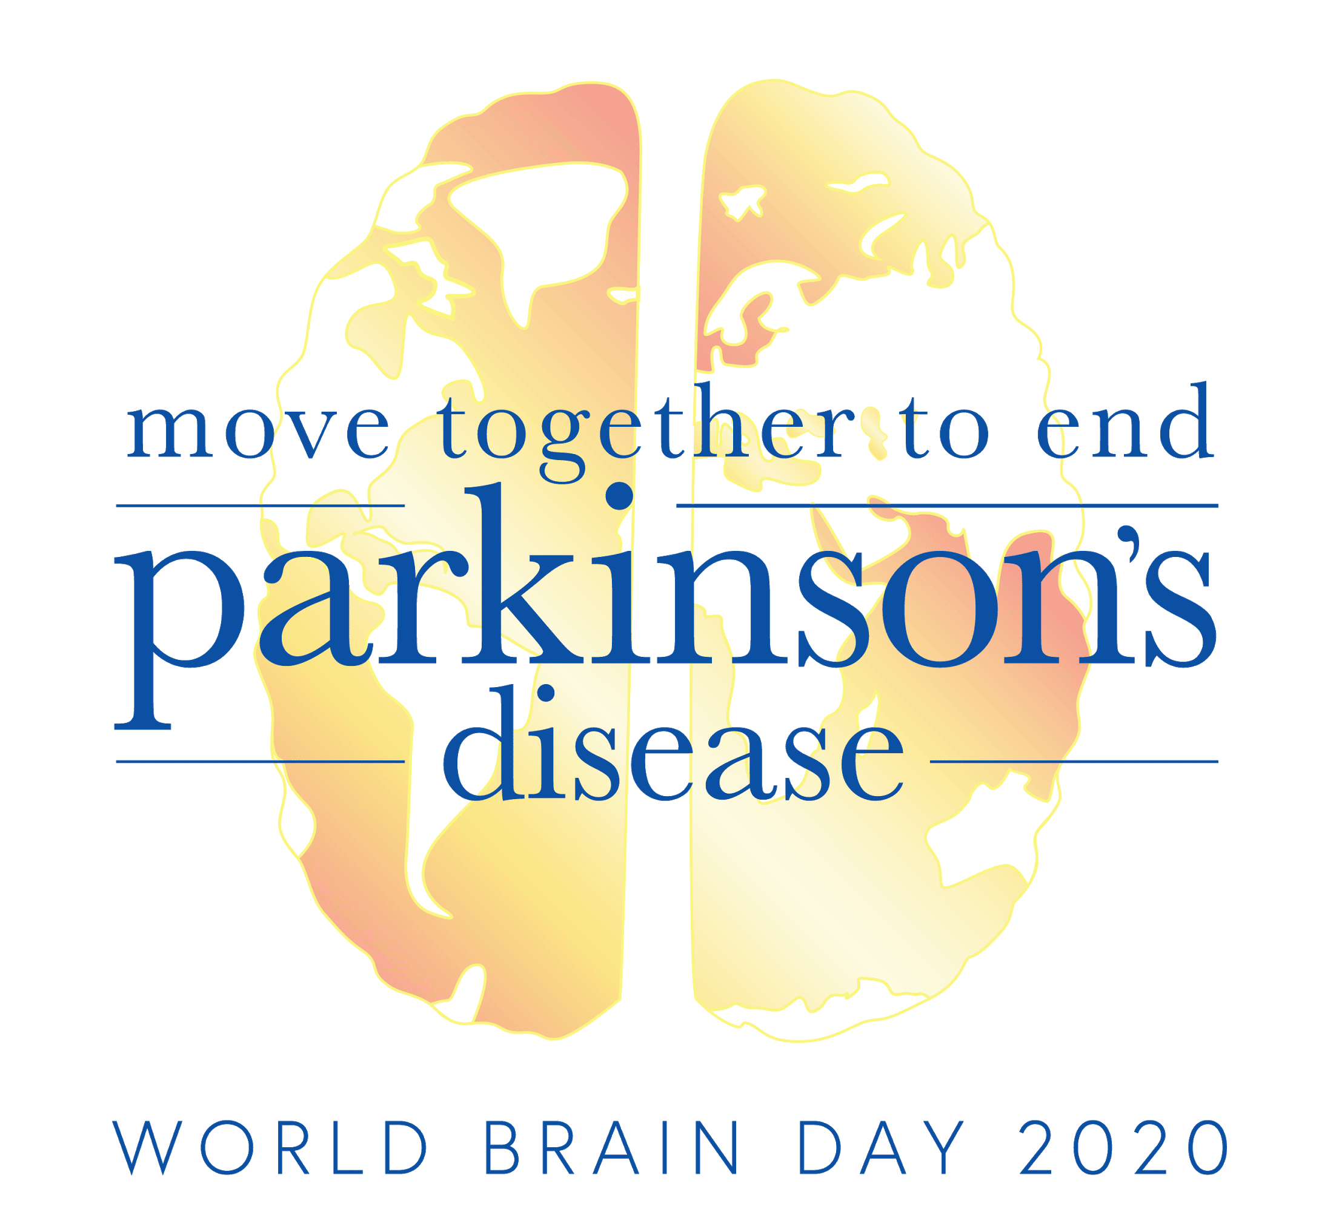



Slide 2
World Brain Day 2020
On July 22, 2020 let’s work together to diagnose earlier, treat more effectively, and improve the lives of those living with Parkinson’s Disease and their caregivers.
July 22, 2020

Slide 3
Move Together to
End Parkinson’s
The World Federation of Neurology and International Parkinson and Movement Disorder Society (MDS) have partnered to raise awareness and improve the lives of those with Parkinson’s Disease and their caregivers.
Together we are advocating for improved patient care, education, and additional research for those living with Parkinson’s Disease and their caregivers.
#WorldBrainDay

Slide 4
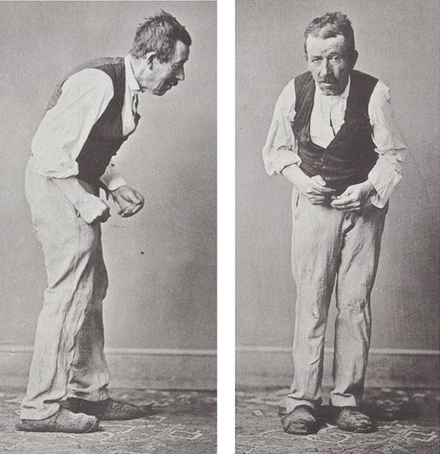
What is
Parkinson’s Disease?
Parkinson's disease (PD) is a neurodegenerative disorder that affects multiple regions of the brain and autonomic nervous system
Loss of dopamine-producing cells in the brain produces the most well-known symptoms of tremor, slowness, stiffness and problems with walking and balance
Symptoms generally develop slowly over years
Its cause remains largely unknown; although there is no cure, many highly effective symptomatic treatment options exist
https://onlinelibrary.wiley.com/doi/10.1002/mds.27965

Slide 5
Who is impacted by Parkinson’s Disease?
PD affects more than 7 million people of all ages, races and ethnicities worldwide
Prevalence continues to increase
  1 million people in USA
  Expected to increase 20%+
  over next 10 years
Predominantly affects older people
  1:100,000 under age 50
  1:100 people over age 60
  1:50 people over age 75

Slide 6
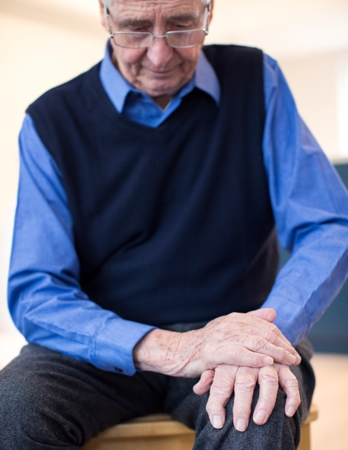
Living with
Parkinson’s Disease
PD affects many aspects of neurological function, and symptoms often worsen
over time.
Movements are slow, stiffer, and shaky, with difficulty with walking and falls
Sleep disturbance, gastrointestinal symptoms and pain are all common
Cognitive symptoms such as hallucinations or dementia eventually affect almost 1/3 of people with PD
Affects all aspects of life
Mood disturbances
  Anxiety
  Depression
  Reduced motivation
Long term disability impacts the person with PD as well as families and caregivers

Slide 7
Treating
Parkinson’s Disease
People with PD require correct diagnosis and active management of their symptoms
Motor and non-motor symptoms can be treated with medical and non-medical therapies
Dopamine replacement with levodopa is a life-changing treatment to be regarded as an essential medication
Long term follow-up by PD experts and healthcare professionals is necessary for optimising and managing the many aspects of PD
Interdisciplinary care improves quality of life with PD

Slide 8
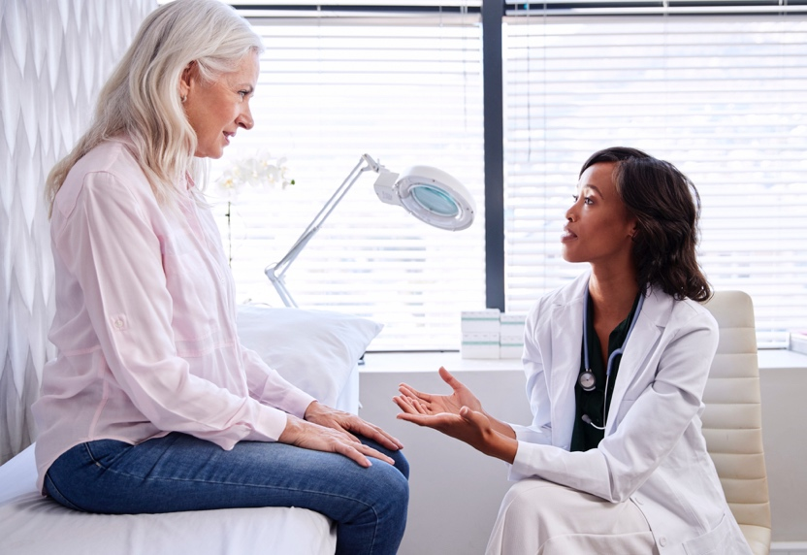
Standard of Care
Access to quality neurological care and essential medications for PD are unavailable in many parts of the world
1 neurologist for every 20,000 people in developed countries, as few as only 1 neurologist for every 3,000,000 people in developing countries
Access to other PD or movement disorder specialists can be even more scarce; some nations have none
In some parts of the world, essential medications such as levodopa are not available or affordable

Slide 9
Parkinson’s
Disease Research
Additional resources are needed to understand the cause, progression and treatment of PD
Research ranges from laboratory efforts to understand the mechanism of brain cell death in order to design disease-modifying therapies, to genetic and clinical studies to discover more effective symptomatic treatments
Almost 500 clinical PD studies worldwide are currently recruiting participants
PD research needs to be collaborative and multidisciplinary, and include:
  Neurologists and other PD specialist clinicians
  PD specialist health care professionals from other disciplines
  Scientists studying basic cellular mechanisms of disease

Slide 10

Parkinson’s Disease Moving Forward
Multiple efforts are ongoing to identify the influence of individual genetics, as well as linking cellular pathology to clinical symptoms (and vice versa)
Researchers are developing therapies for all PD symptoms, including non-motor issues like mood disorders, as well as problems with sleep, digestion, speech and swallowing
Living well with PD needs multidisciplinary medical care combined with optimized lifestyle

Slide 11
Additional Resources
International Parkinson and Movement Disorder Society (MDS)
(click Parkinson’s disease for list of global organizations)​
MDS Educational Resources
- Movement Disorders Fundamentals E-Learning
Course Series
- Patient Education handouts (21 topics in 30 languages)
- Invitation to MDS Virtual Congress Sept. 12-16, 2020
World Parkinson Coalition
(scroll down for organizational links by region)​
National Institutes of Health-NINDS (USA)​
- PD facts, Hope through Research publication, & more
Parkinson’s Foundation​ (USA)​
Michael J. Fox Foundation (USA)​

Slide 12
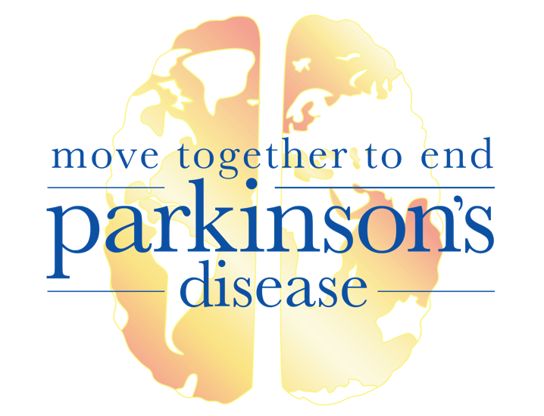
Learn more about www.wfneurology.org/world-brain-day-2020

